Slide 1

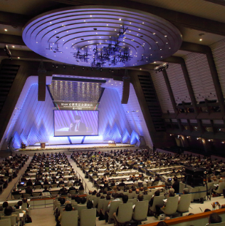
https://www.kyotoprize.org/en/lectures/2025

Slide 2
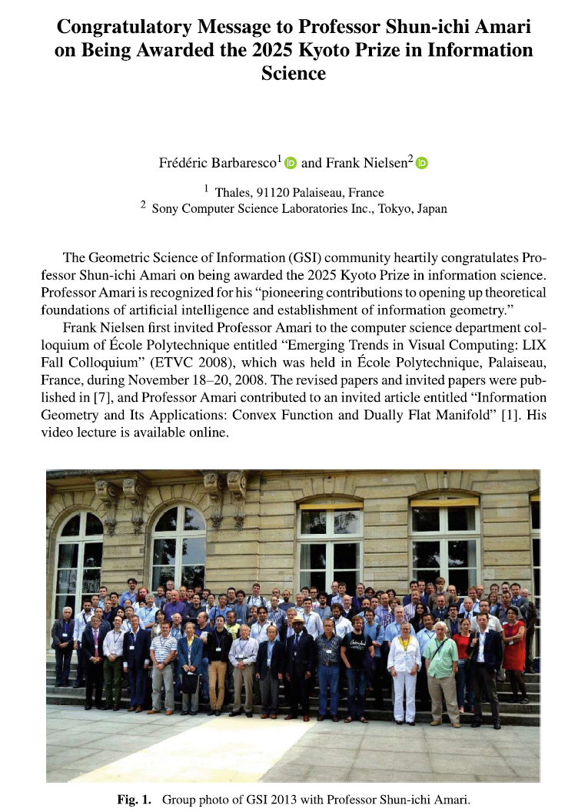


Slide 3


Slide 4

Downtown Kyoto city

Slide 5
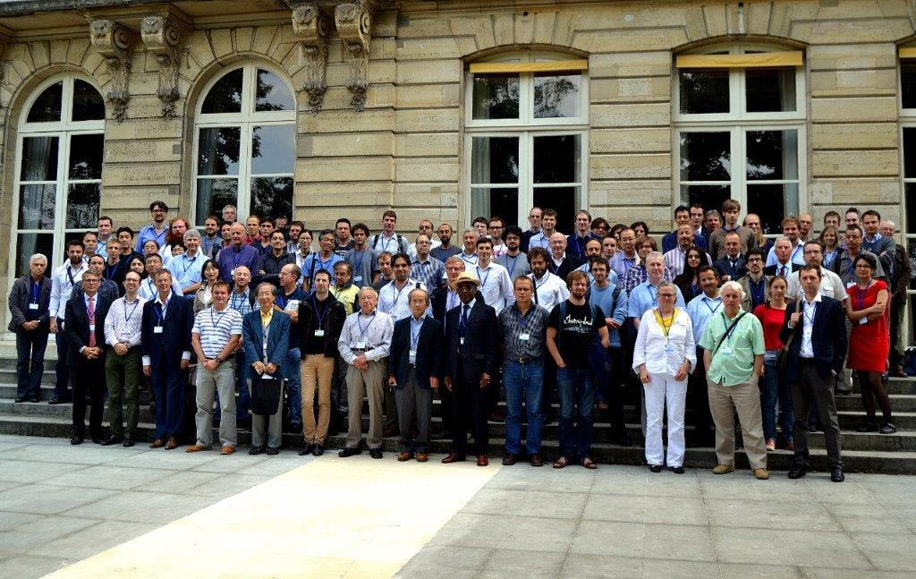
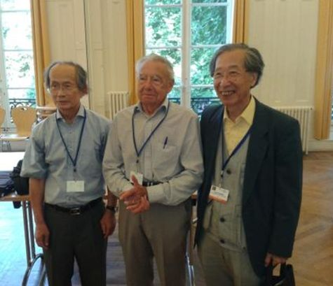
GSI’13 (Ecole des mines)

Slide 6
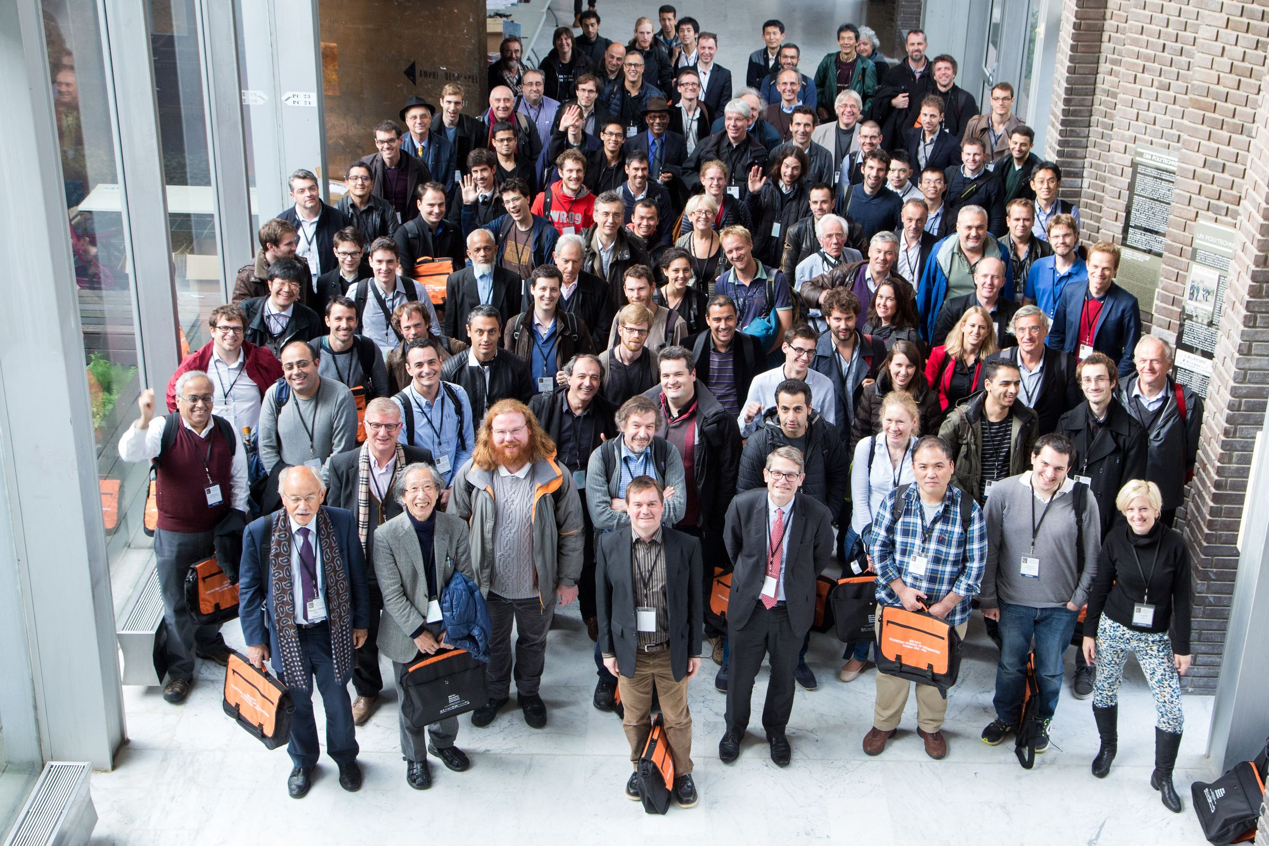
GSI’15 (Ecole Polytechnique)

Slide 7


Shun-ichi Amari, Takeru Matsuda:
Wasserstein Statistics in One-Dimensional Location-Scale Models. GSI 2021: 499-506
Ryo Karakida, Shun-ichi Amari:
Information Geometry of Wasserstein Divergence. GSI 2017: 119-126
John Armstrong, Shun-ichi Amari:
The Pontryagin Forms of Hessian Manifolds. GSI 2015: 240-247
Shun-ichi Amari, Nihat Ay:
Standard Divergence in Manifold of Dual Affine Connections. GSI 2015: 320-325
Shun-ichi Amari:
Information Geometry and Its Applications: Survey. GSI 2013: 3
But also keynote talk at ETVC 2008@Ecole Polytechnique

Slide 8


https://link.springer.com/book/10.1007/978-3-032-03918-7
https://link.springer.com/book/10.1007/978-3-032-03921-7
https://link.springer.com/book/10.1007/978-3-032-03924-8
Notes:
https://link.springer.com/book/10.1007/978-3-032-03918-7
https://link.springer.com/book/10.1007/978-3-032-03921-7
https://link.springer.com/book/10.1007/978-3-032-03924-8

Slide 9

Proceedings QR code

Slide 10
Topics of GSI’25
Geometric Learning and Differential Invariants on Homogeneous Spaces Statistical Manifolds and Hessian information geometry Applied Geometry-Informed Machine Learning Geometric Green Learning on Groups and Quotient Spaces Divergences in Statistics and Machine Learning Geometric Statistics Computational Information Geometry and Divergences Geometric Methods in Thermodynamics Classical & Quantum Information, Geometry and Topology Geometric Mechanics Stochastic Geometric Dynamics New trends in Nonholonomic Systems Learning of Dynamic Processes Optimization and learning on manifolds Neurogeometry Lie Group in Learning Distributions & in Filters A geometric approach to differential equations Information Geometry, Delzant Toric Manifold & Integrable System

Slide 11
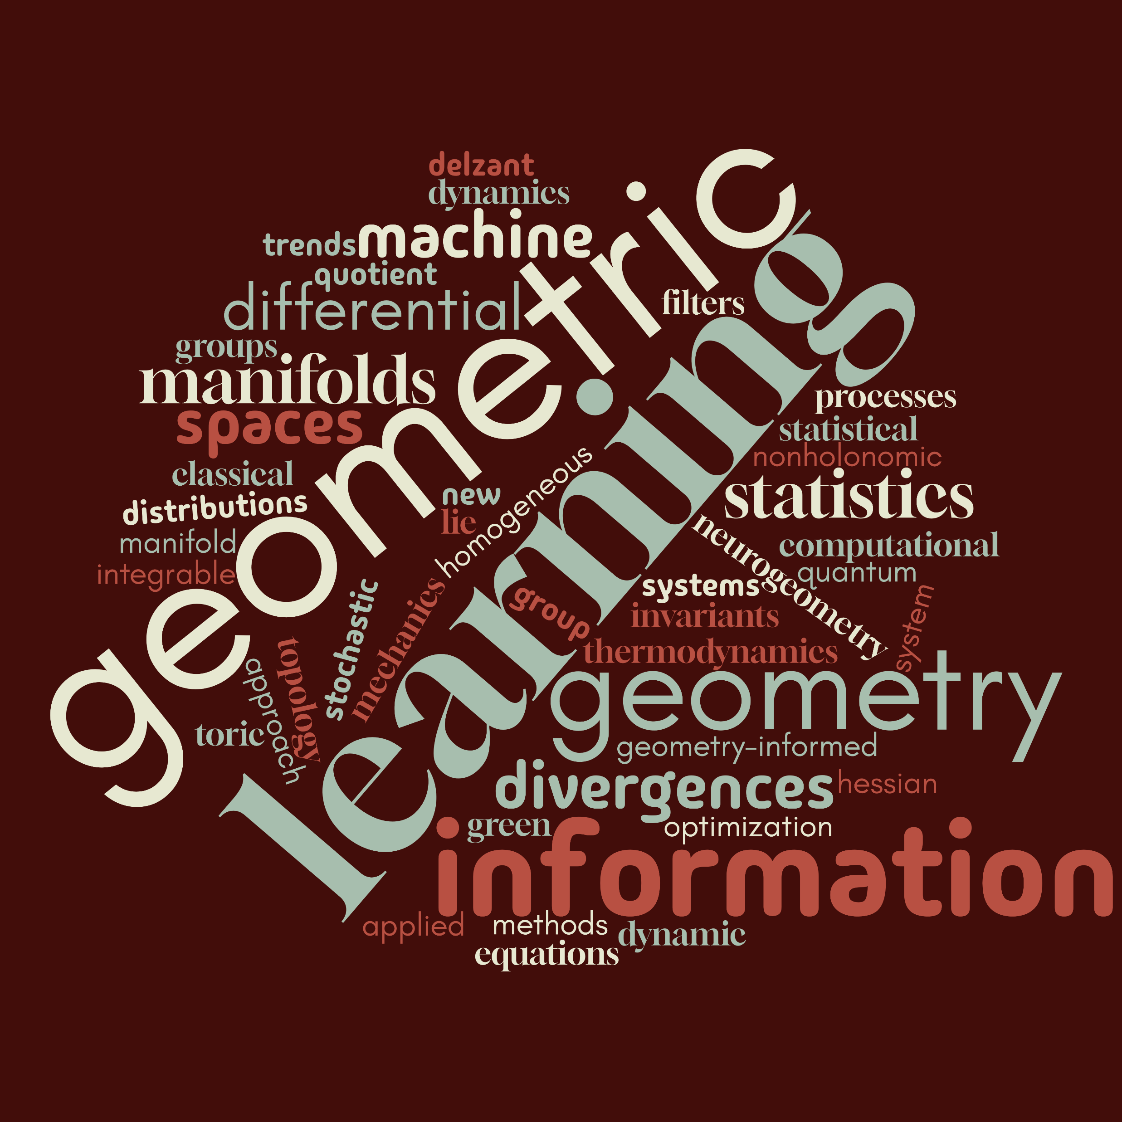
Topics of GSI’25

Slide 12
Geometric Green Learning Neurogeometry Meets Geometric Deep Learning Divergences in Statistics Computational Information Geometry and Divergences Statistical Manifolds and Hessian Information Geometry Statistics, Information and Topology Information Theory and Statistics Statistical Shape Analysis and more Non-Euclidean Statistics Probability and Statistics on Manifolds Computing Geometry and Algebraic Statistics Geometric and Analytical Aspects of Quantization and Non-Commutative Harmonic Analysis on Lie Groups Deep Learning: Methods, Analysis and Applications to Mechanical Systems Stochastic Geometric Mechanics Geometric Mechanics New trends in Nonholonomic Systems Geometry, Learning Dynamics and Thermodynamics Symplectic Structures of Heat and Information Geometry Geometric Methods in Mechanics and Thermodynamics Fluid Mechanics and Symmetry Learning of Dynamic Processes The Geometry of Quantum States Integrable Systems and Information Geometry (From Classical to Quantum) Neurogeometry Bio-Molecular Structure Determination by Geometric Approaches Geometric Features Extraction in Medical Imaging Applied Geometric Learning
Topics of GSI’23

Slide 13
Probability and Statistics on Riemannian Manifolds Shapes Spaces Geometric and Structure Preserving Discretizations Lie Group Machine Learning Harmonic Analysis on Lie Groups Geometric Mechanics Sub-Riemannian Geometry and Neuromathematics Statistical Manifold and Hessian Information Geometry Information Geometry in Physics Geometric and Symplectic Methods for Hydrodynamical Models Geometry of Quantum States Deformed Entropy, Cross-Entropy, and Relative Entropy Geometric Structures in Thermodynamics and Statistical Physics Geometric Deep Learning Computational Information Geometry 1 Computational Information Geometry 2 Optimal Transport and Learning Statistics, Information, and Topology Topological and Geometrical Structures in Neurosciences Manifolds and Optimization Divergence Statistics Transport Information Geometry
Topics of GSI’21

Slide 14
Probability on Riemannian Manifolds
Optimization on Manifold
Shape Space
Statistics on Non-linear Data
Lie Group Machine Learning
Statistical Manifold and Hessian Information Geometry
Monotone Embedding and Affine Immersion of Probability Models
Non-parametric Information Geometry
Divergence Geometry
Computational Information Geometry
Wasserstein Information Geometry/Optimal Transport
Geometric Structures in Thermodynamics and Statistical Physics
Geometric and Structure-Preserving Discretizations
Geometry of Quantum States
Geometry of Tensor-Valued Data
Geometric Mechanics
Geometric Science of Information Libraries
Topics of GSI’19

Slide 15
Statistics on Non-linear Data
Shape Space
Optimal Transport and Applications
Statistical Manifold & Hessian Information Geometry
Monotone Embedding in Information Geometry
Information Structure in Neuroscience
Geometric Robotics and Tracking
Geometric Mechanics and Robotics
Stochastic Geometric Mechanics and Lie Group Thermodynamics
Probability on Riemannian Manifolds
Divergence Geometry
Non-parametric Information Geometry
Optimization on Manifold
Computational Information Geometry
Probability Density Estimation
Geometry of Tensor-Valued Data
Geodesic Methods with Constraints
Applications of Distance Geometry
Topics of GSI’17

Slide 16
Dimension Reduction on Riemannian Manifolds
Optimal Transport
Optimal Transport and Applications in Imagery/Statistics
Shape Space and Diffeomorphic Mappings
Random Geometry and Homology
Hessian Information Geometry
Topological Forms and Information
Information Geometry Optimization
Information Geometry in Image Analysis
Divergence Geometry
Optimization on Manifold
Lie Groups and Geometric Mechanics/Thermodynamics
Computational Information Geometry
Lie Groups: Novel Statistical and Computational Frontiers
Geometry of Time Series and Linear Dynamical Systems
Bayesian and Information Geometry for Inverse Problems
Probability Density Estimation
Topics of GSI’15

Slide 17
Geometric Statistics on Manifolds and Lie Groups
Deformations in Shape Spaces
Differential Geometry in Signal Processing
Relational Metric
Discrete Metric Spaces
Computational Information Geometry
Hessian Information Geometry I and II
Computational Aspects of Information Geometry in Statistics
Optimization on Matrix Manifolds
Optimal Transport Theory
Probability on Manifolds
Divergence Geometry and Ancillarity
Entropic Geometry
Tensor-Valued Mathematical Morphology
Machine/Manifold/Topology Learning
Geometry of Audio Processing
Geometry of Inverse Problems
Algebraic/Infinite Dimensional/Banach Information Manifolds
Information Geometry Manifolds
Algorithms on Manifolds
Topics of GSI’13

